Slide 1

MINI PROJECT PRESENTATION
On
CAR SHOWROOM MANAGEMENT SYSTEM
By
ABHIJEET KUMAR 1DS19IS002
APOORVA S V 1DS19IS020

Slide 2
Problem Statement
The purpose of Car Showroom Management System is to automate the existing manual system by the help of computerized equipments and full-fledged computer software, fulfilling their requirements, so that their valuable data/information can be stored for a longer period with easy accessing and manipulation of the same. The required software and hardware are easily available and easy to work with..

Slide 3
The "Car Showroom Management System" has been developed to override the problems prevailing in the practicing manual system.
This software is supported to eliminate and in some cases reduce the hardships faced by this existing system.
Moreover this system is designed for the particular need of the company to carry out operations in a smooth and effective manner.
It is easier to add and delete details of cars and companies.
It is easier for viewing the available cars and the companies.
It is also easy to book cars .

Slide 4
Hardware Requirements:
Processor: - Pentium I or above.
RAM: - 128 MB or above.
HD: - 20 GB or above.
Software Requirements :-
Front end- PHP
Back end- MySql
Server - XAMPP

Slide 5
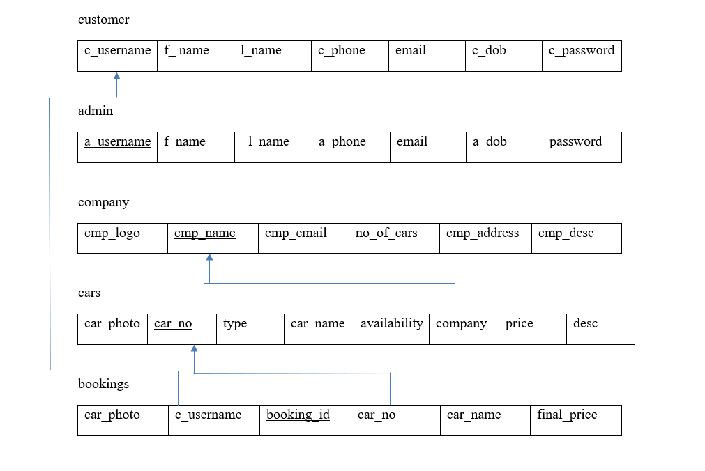
Schema

Slide 6
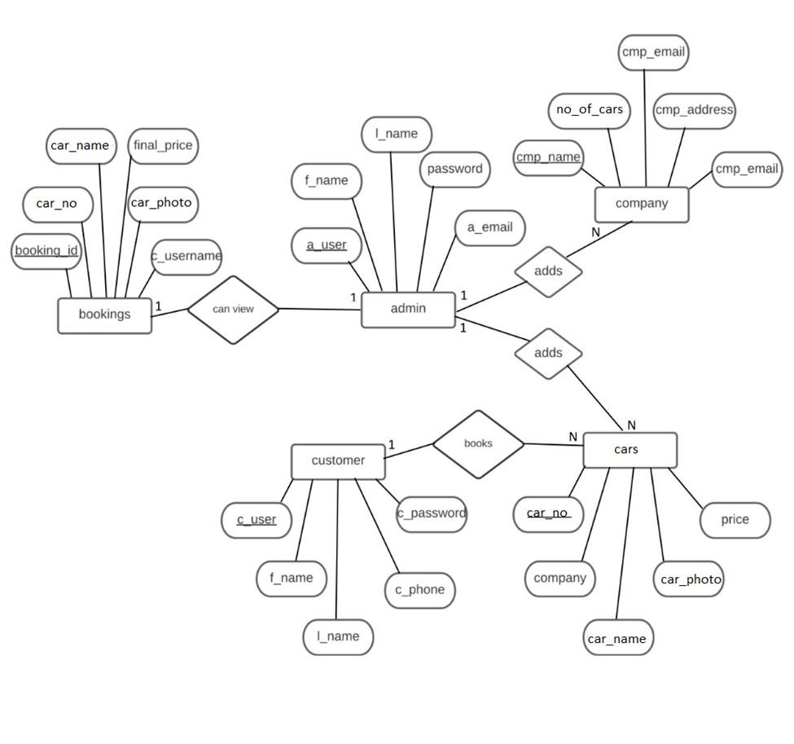
ER DIAGRAM

Slide 7
TRIGGERS :
-- Trigger to increment the no_of_cars attribute of company table by 1 when a car information is added to the cars table.
CREATE TRIGGER add_car
AFTER INSERT ON cars
FOR EACH ROW
UPDATE company
SET no_of_cars =no_of_cars+1
WHERE cmp_name = new.company;
-- Trigger to decrement the no_of_cars attribute of company table by 1 when a car information is removed from the cars table.
CREATE TRIGGER remove_car
AFTER DELETE ON cars
FOR EACH ROW
UPDATE company
SET no_of_cars = no_of_cars-1
WHERE cmp_name = old.company;

Slide 8
STORED PROCEDURES :
--STORED PROCEDURE.
DELIMITER //
CREATE PROCEDURE ViewBookings()
BEGIN
SELECT * FROM `bookings`;
END;
//
DELIMITER ;

Slide 9
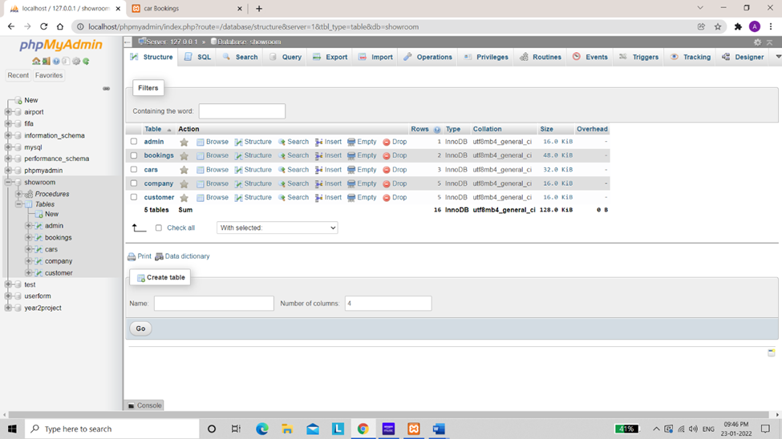

Slide 10
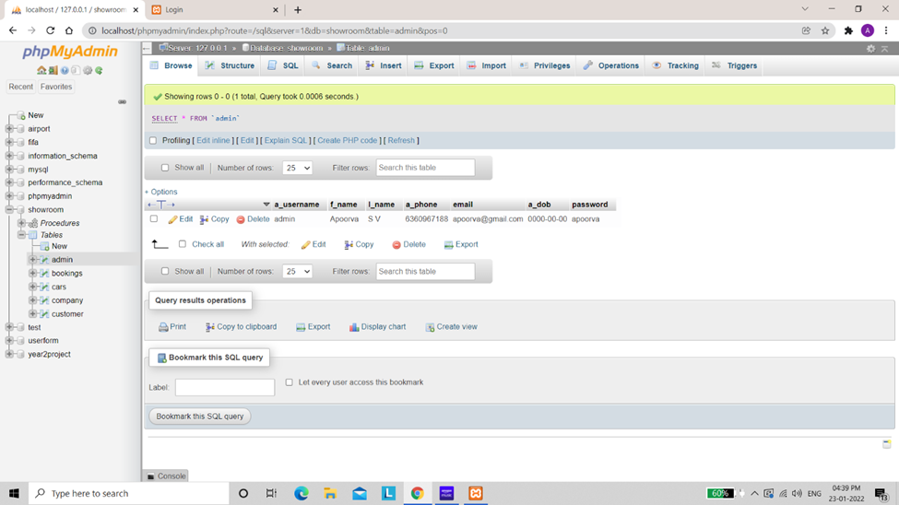

Slide 11
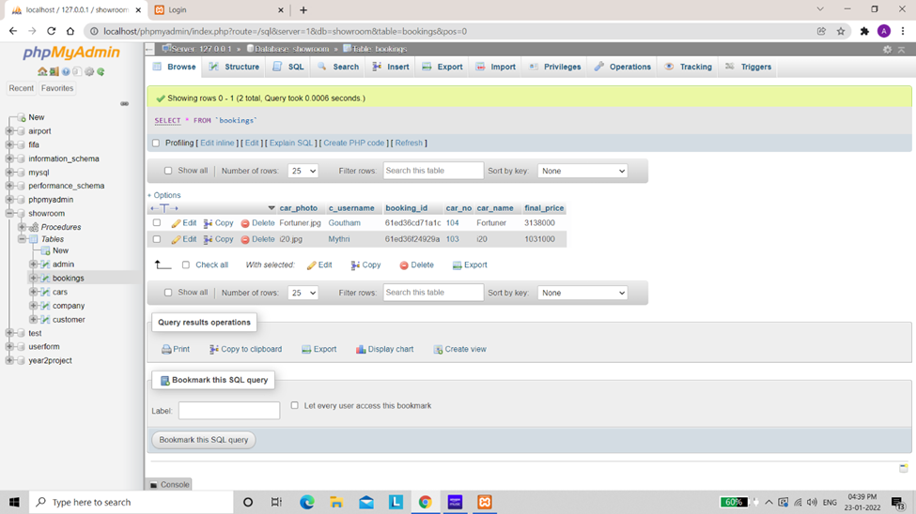

Slide 12
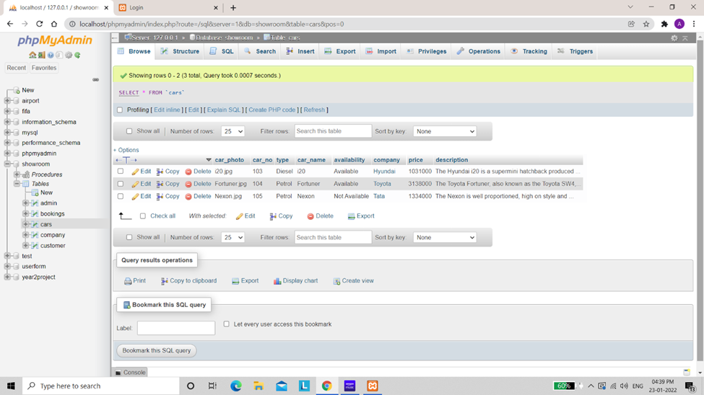

Slide 13
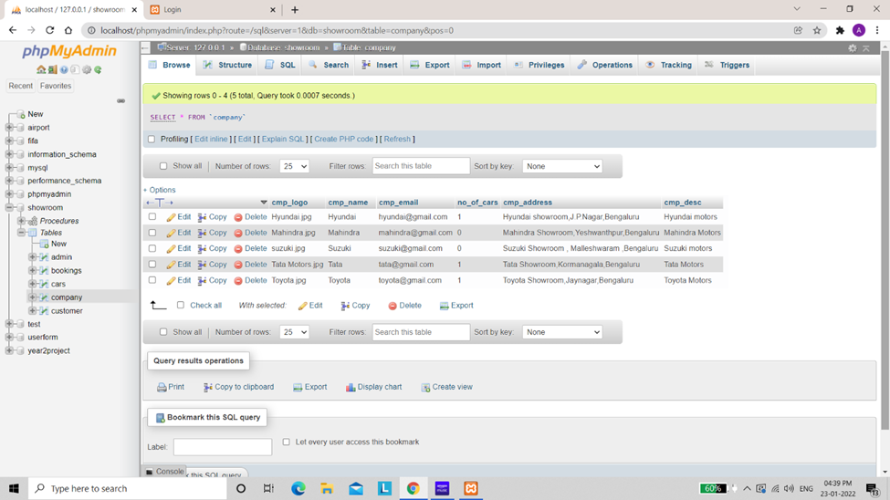

Slide 14
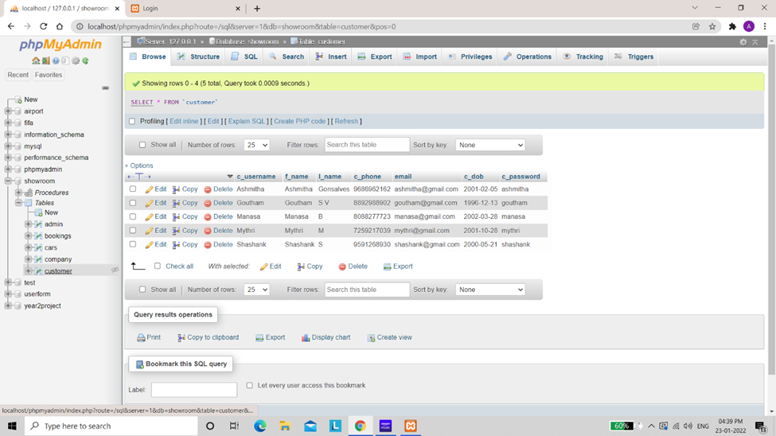

Slide 15
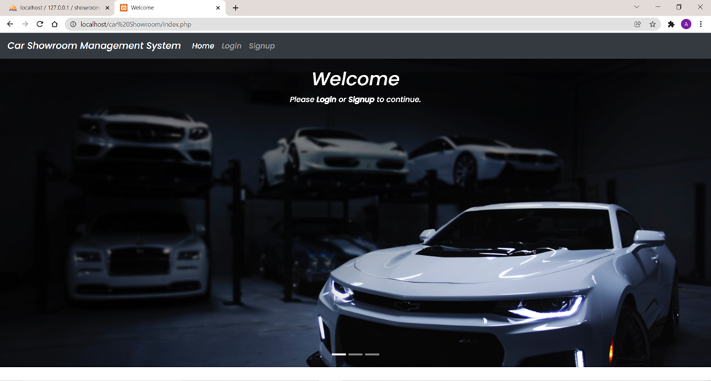

Slide 16
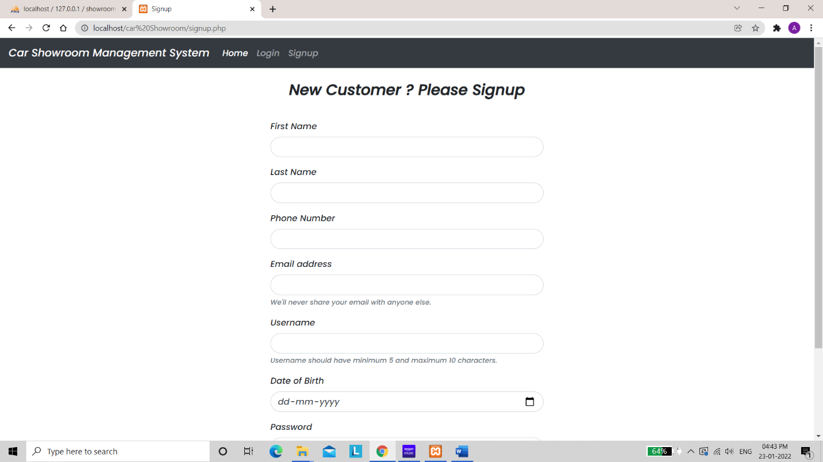

Slide 17
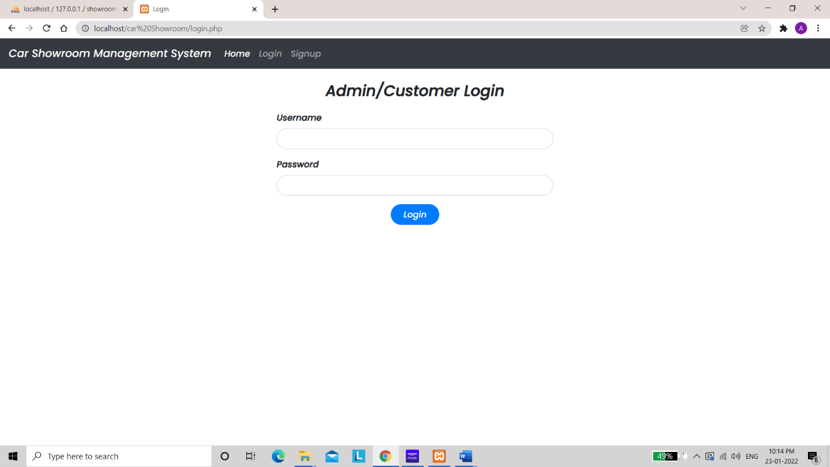

Slide 18
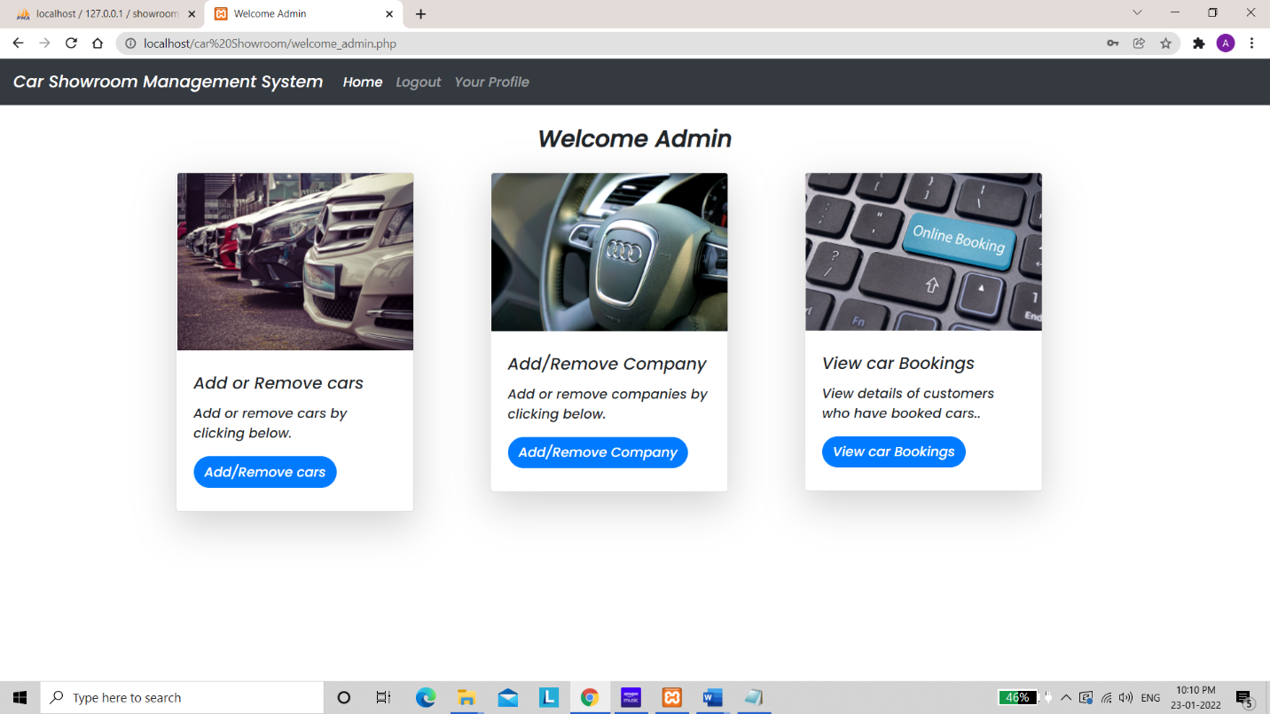

Slide 19
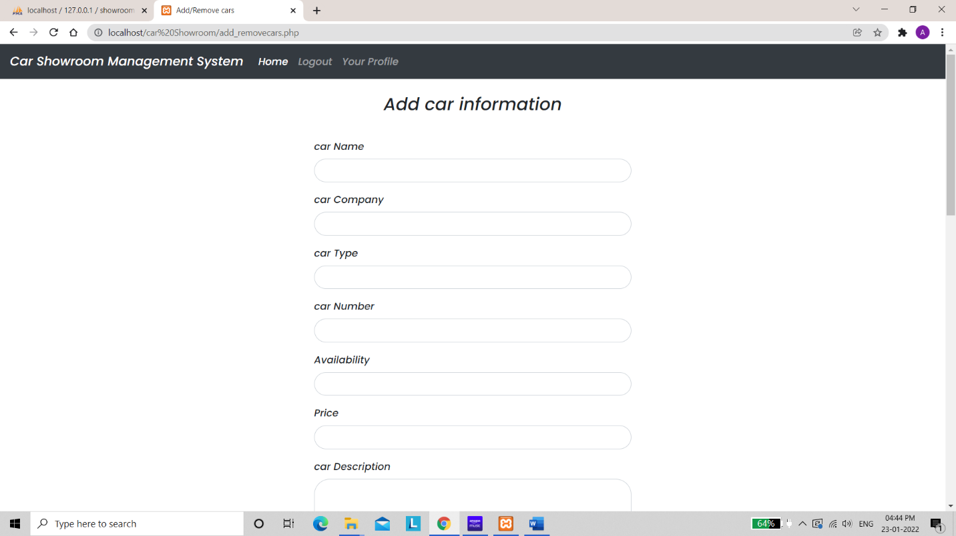

Slide 20
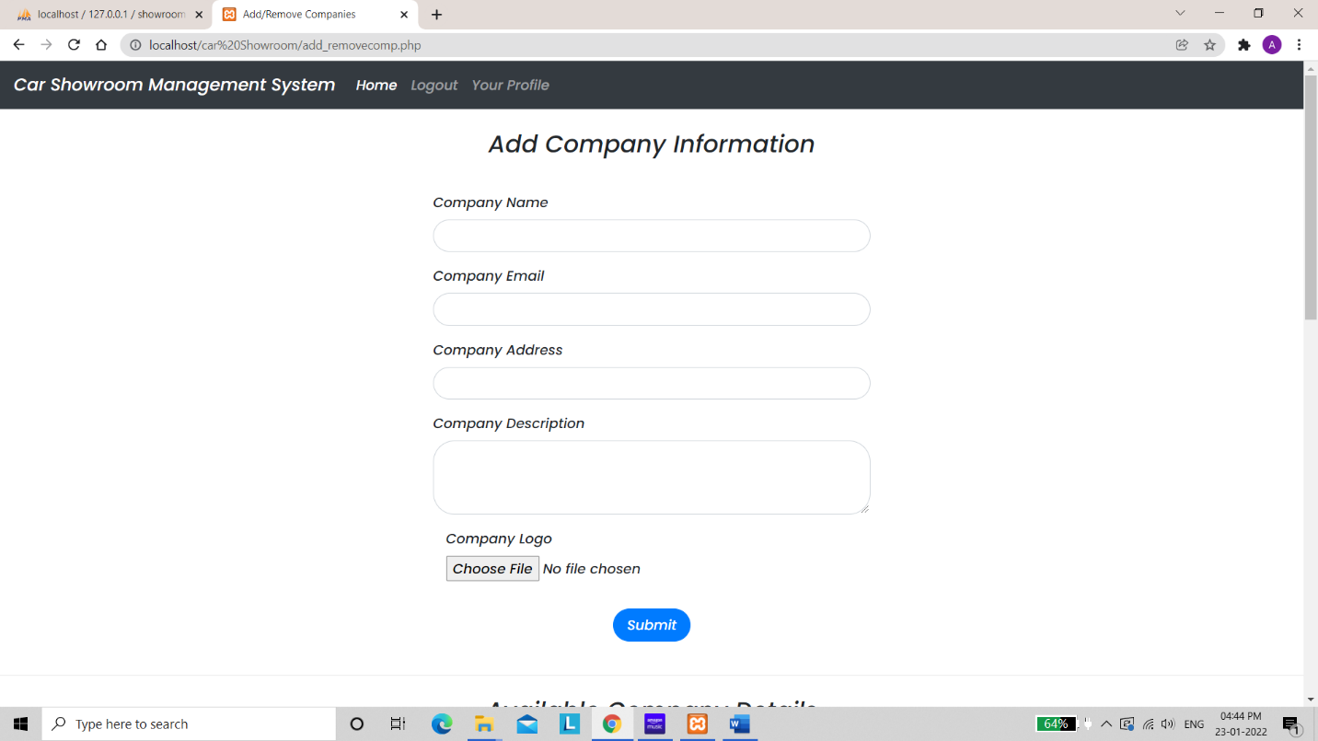

Slide 21
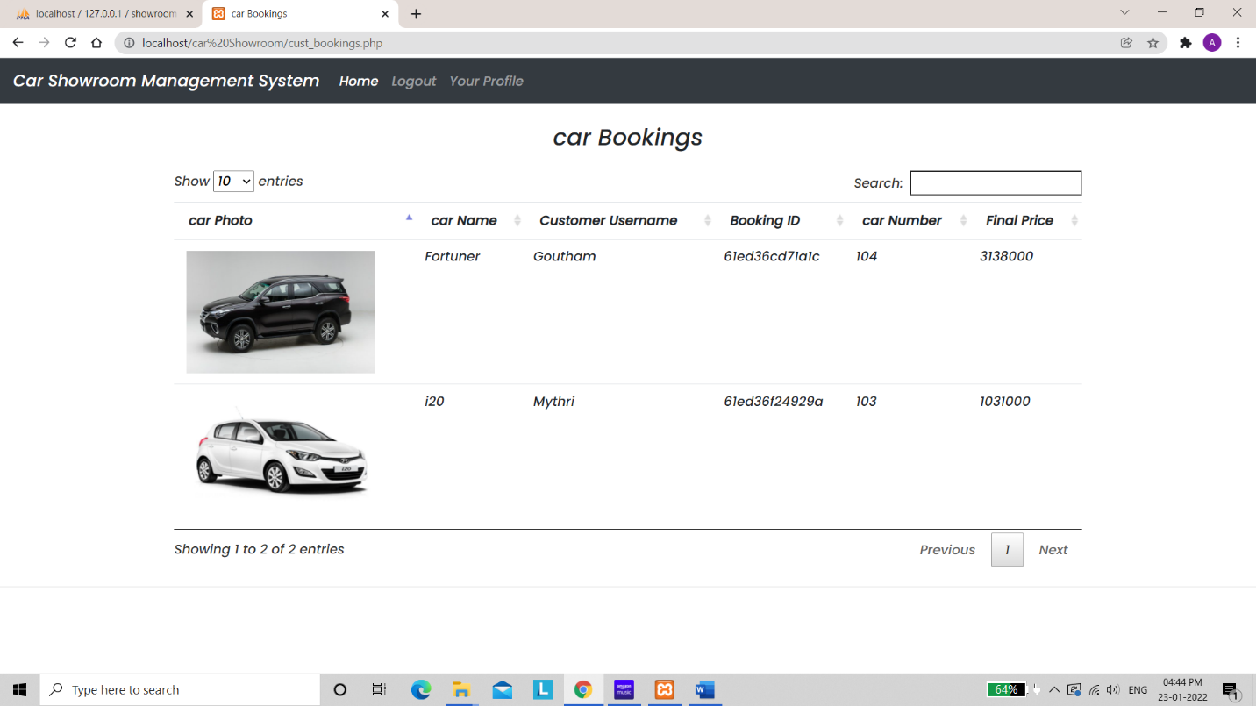

Slide 22
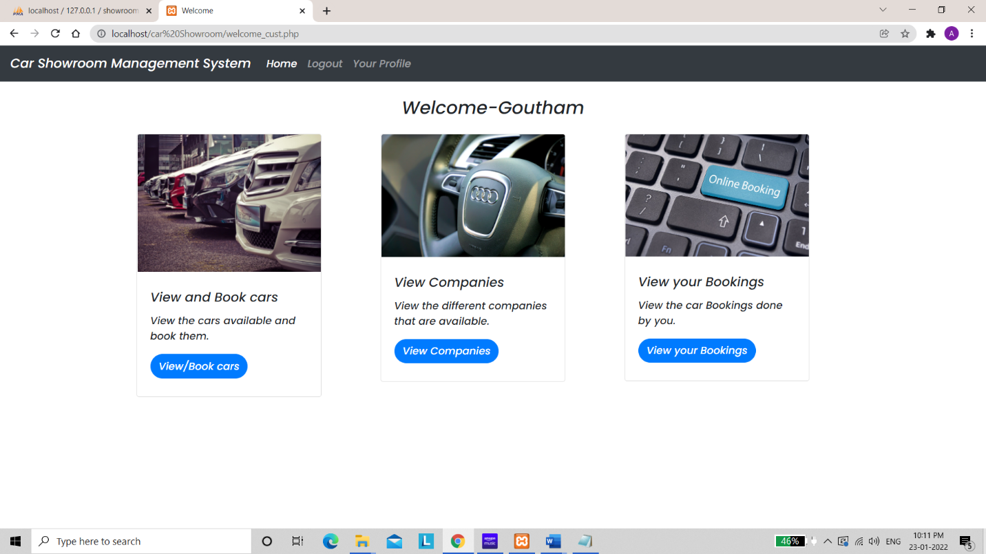

Slide 23
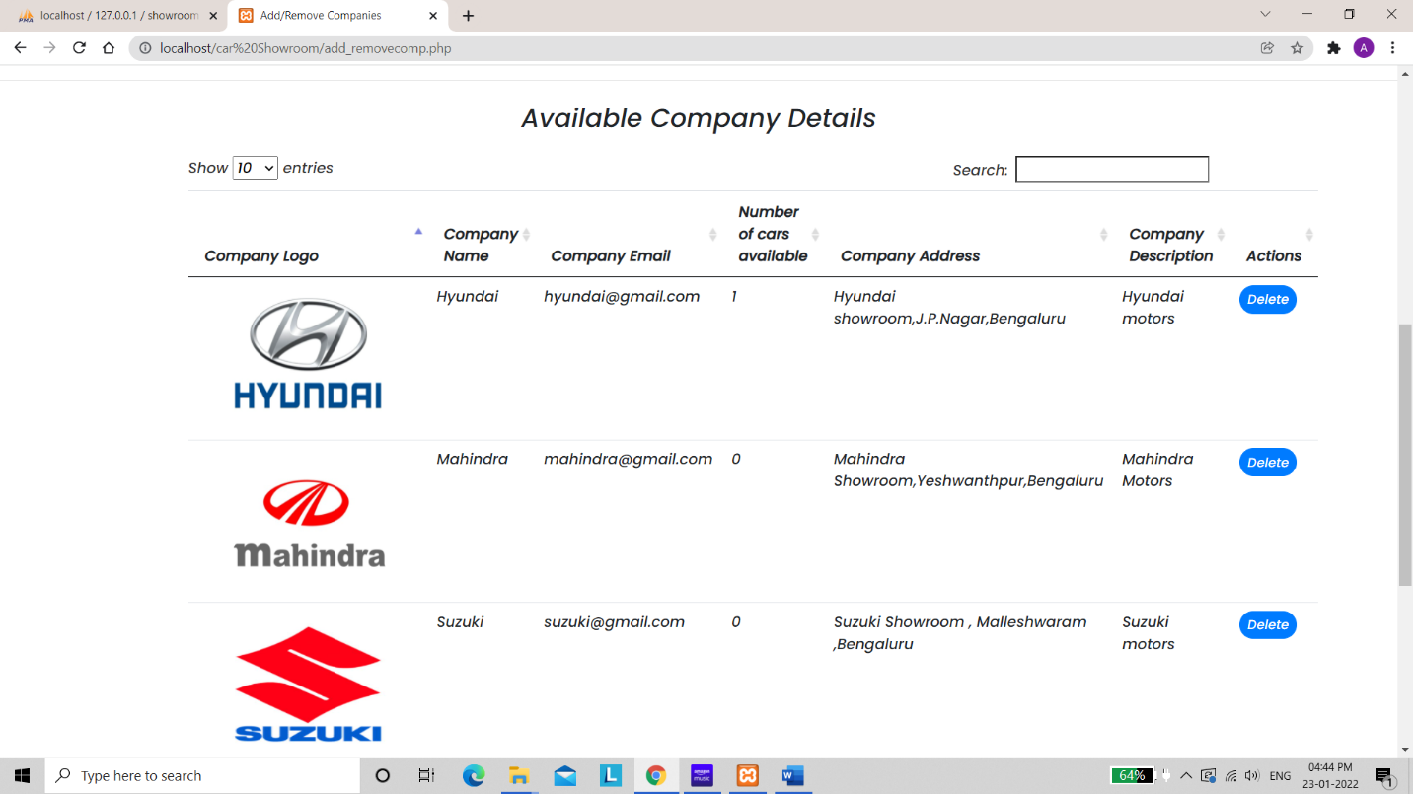

Slide 24
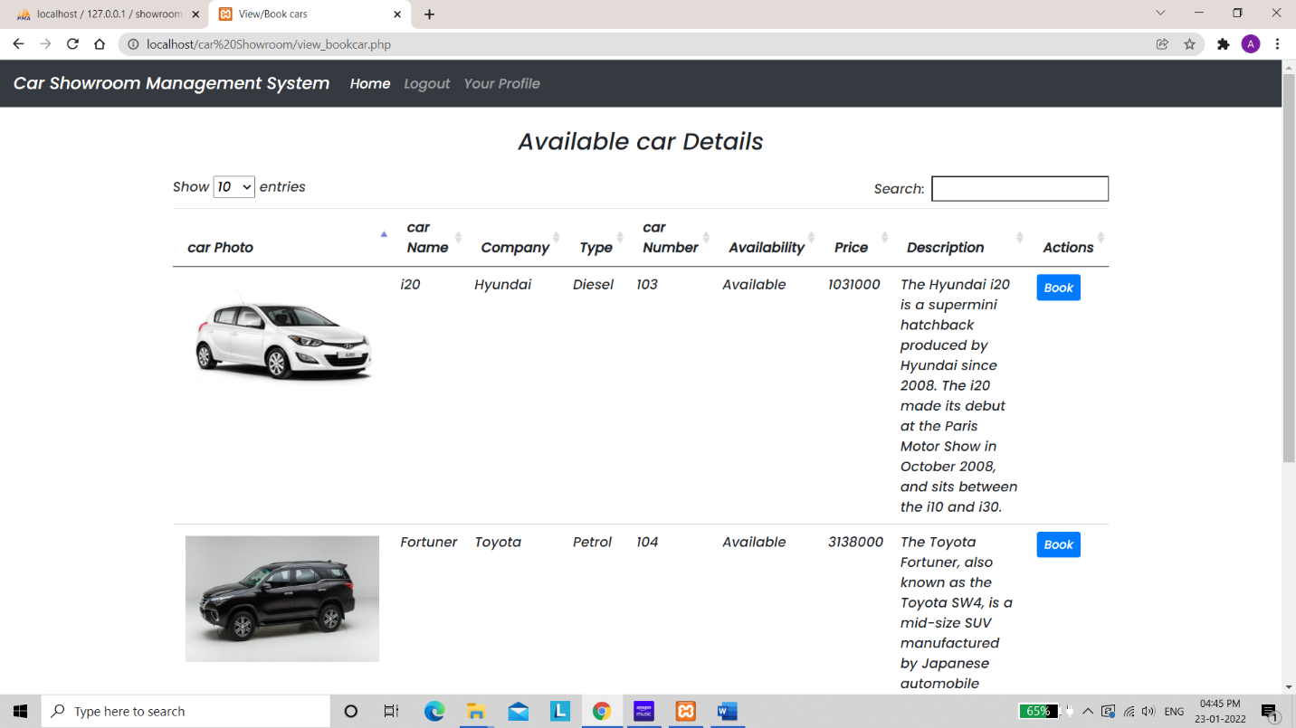

Slide 25
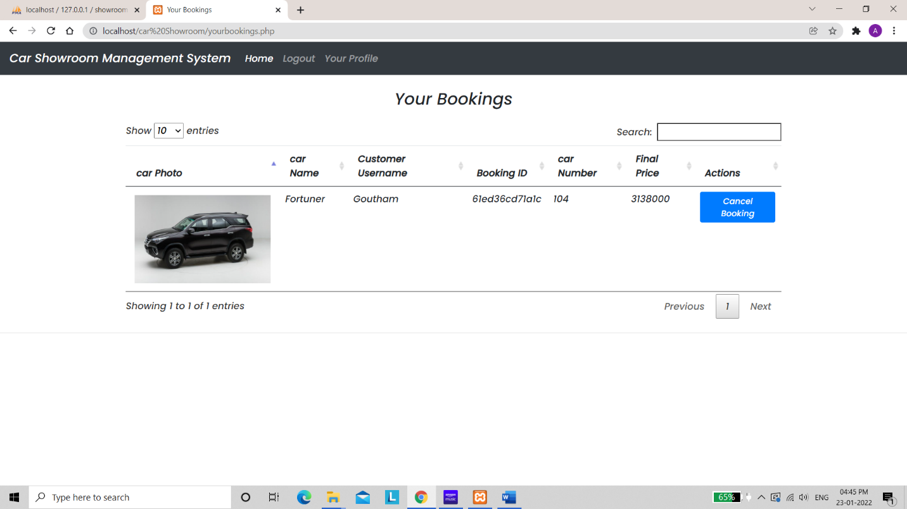

Slide 26
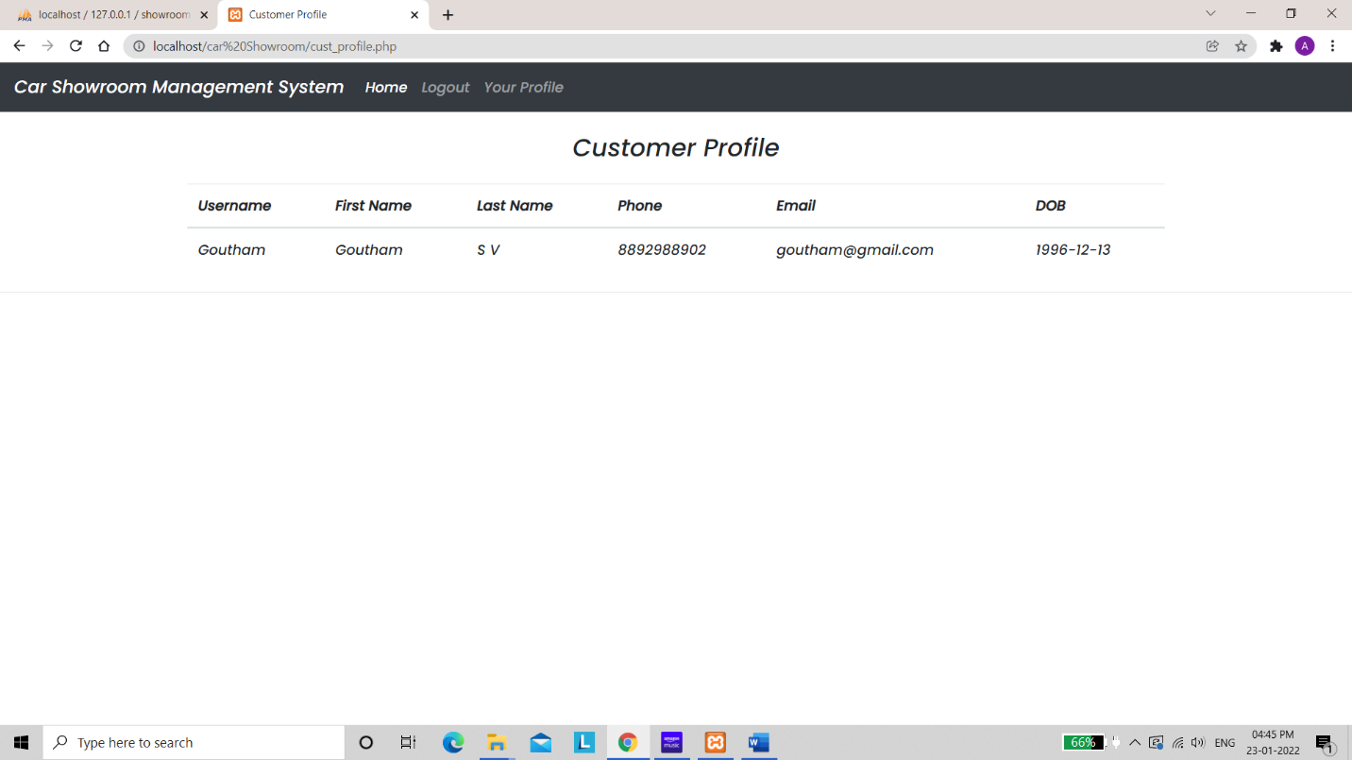

Slide 27


Slide 28
THANK YOU

